Slide 1
Lecture 9
Sampling, Experiments and Causation

Slide 2
Review
1 What is bias?
When a sampling method's estimates miss the parameter in the same direction every time - an accuracy problem.
2 What is standard error?
How much an estimate varies from one sample to the next - a precision problem.
3 What is random sampling?
Using chance, not a person, to decide which units get into the sample.
4 What is a simple random sample (SRS)?
Every possible group of n units has the same chance of being the sample.

Slide 3
Review
5 What is a convenience sample?
A sample of whoever is easiest to reach.
6 What is sampling with replacement?
A picked unit goes back into the pool, so it can be picked again.
7 What is sampling without replacement?
A picked unit is set aside, so it can be chosen only once.
8 What is a voluntary response sample?
A sample of people who choose themselves by responding - usually the ones with strong opinions.

Slide 4
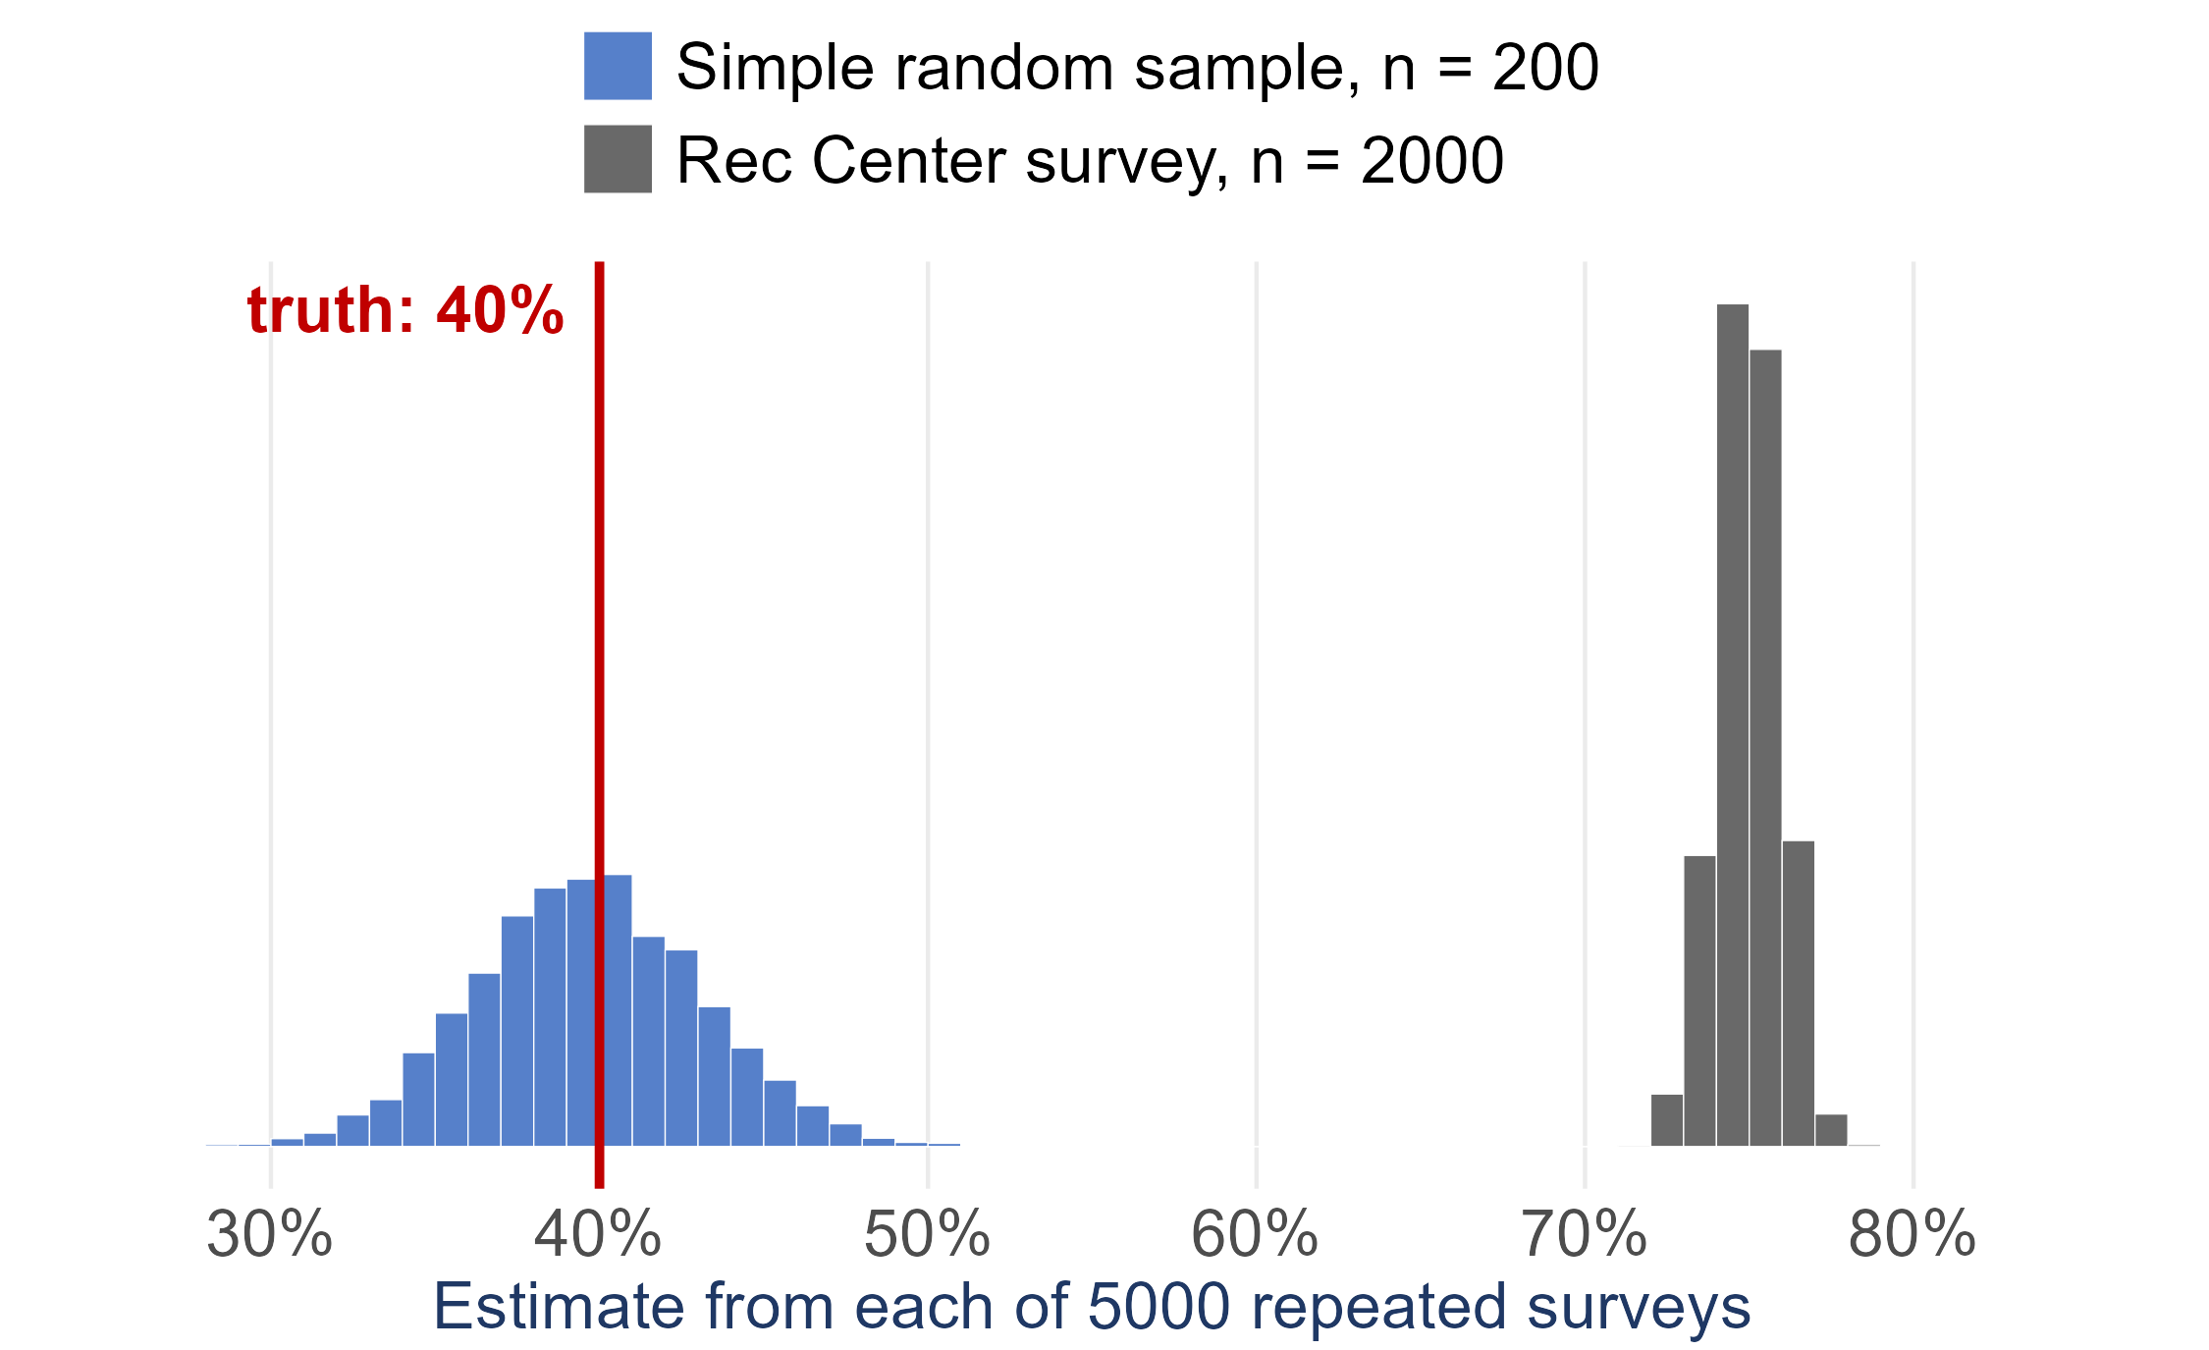
A bigger sample does not fix bias
Suppose 40% of UI students exercise at least three times a week
Blue: 5000 simple random samples of 200 students
Grey: 5000 Rec Center surveys of 2000 students
The Rec Center survey is more precise - a smaller standard error
and every one of its estimates misses the truth: bias
More data buys precision. Only a better design buys accuracy

Slide 5
In the news: how a national poll samples
State of the Facts 2026 (AP-NORC Center with USAFacts) asked U.S. adults how much they trust government information and AI
1,036 adults, July 29 – August 10, 2026: 1,017 online and 19 by phone, in English or Spanish
Drawn from AmeriSpeak, a probability-based panel: NORC randomly selects U.S. addresses, then recruits those households by mail, phone and in person
You cannot sign yourself up - chance decides who is invited. Compare the opt-in panels from last week
Margin of sampling error: ±4.1 percentage points
But only 10.3% of invited panel members completed this survey (AAPOR response rate 3)
One finding: only 37% say it is easy to know whether the information they see is true
Read more: Project page · Full report (PDF; methods on p. 42) · How AmeriSpeak recruits
Sources: AP-NORC Center for Public Affairs Research and USAFacts (2026); NORC, About AmeriSpeak

Slide 6
In the news: light at night, over time
UK Biobank: about 500,000 UK adults aged 40–69 who agreed to join in 2006–2010, then followed through their health records
2013–2015: 103,615 of them wore a wrist sensor with a light meter for 7 days
Removed: unreliable sensor data, 2,770 night-shift workers, anyone with heart disease already, anyone without a later heart MRI → 11,071 people
About 3 years later each had an MRI of their heart; hospital and death records were followed for up to 10 years
Longitudinal: the same people measured more than once - night light first, the heart later
Not random: the people who agreed to join are mostly White and healthier than the UK population (the authors say so)
Result: more light above 3 lux at night went with thicker heart walls and weaker pumping. Did the light cause it? We come back to that later today
Read more: ESC press release · Dai et al. (2026), European Heart Journal
Sources: Dai, Dai, Heianza and Qi (2026), European Heart Journal; ESC press release (2026)

Slide 7
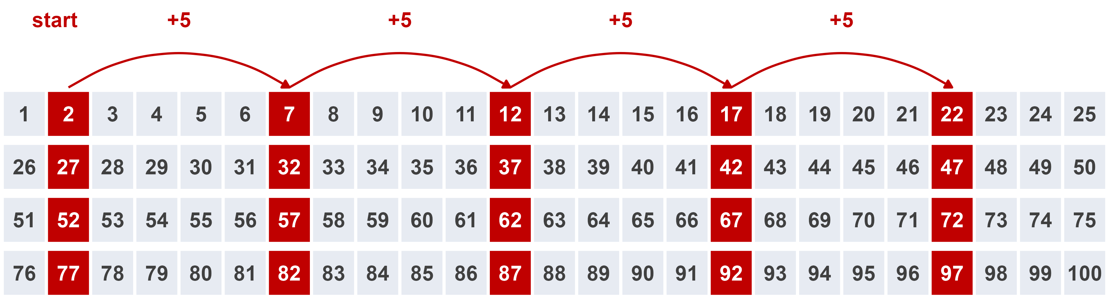
Systematic sample
systematic sample
pick a random starting point among the first k units of an ordered list, then take every kth unit after it
k = N/n = 100/20 = 5. Random start = 2, so we take list positions 2, 7, 12, 17, ... , 97
Works like an SRS - unless the list has a repeating pattern that lines up with k

Slide 8
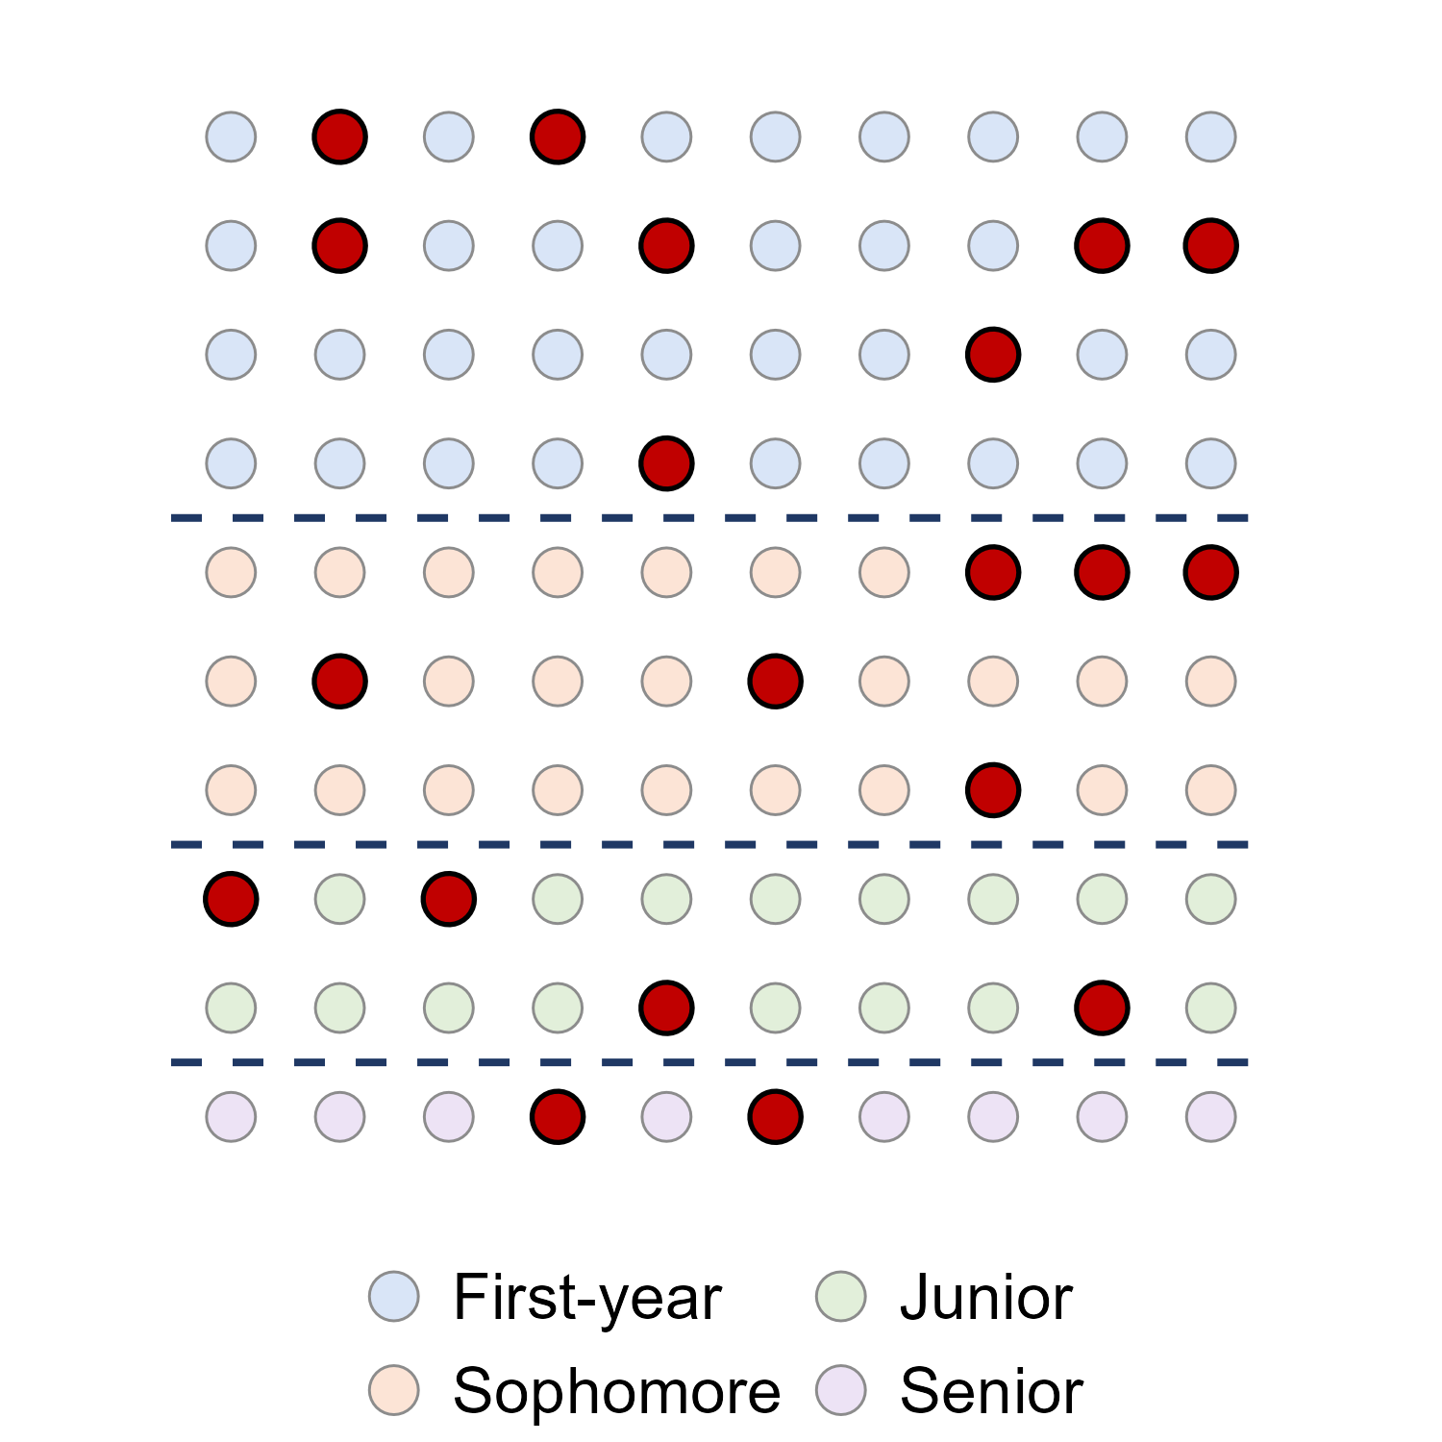
Stratified random sample
strata
groups of units that are alike, formed BEFORE sampling - class year, region, age group
stratified random sample
a separate SRS inside every stratum, combined into one sample
proportional allocation
each stratum gets its share of n: 40, 30, 20, 10 students -> 8, 6, 4, 2
Every group is guaranteed a place - no more 2 juniors by bad luck

Slide 9
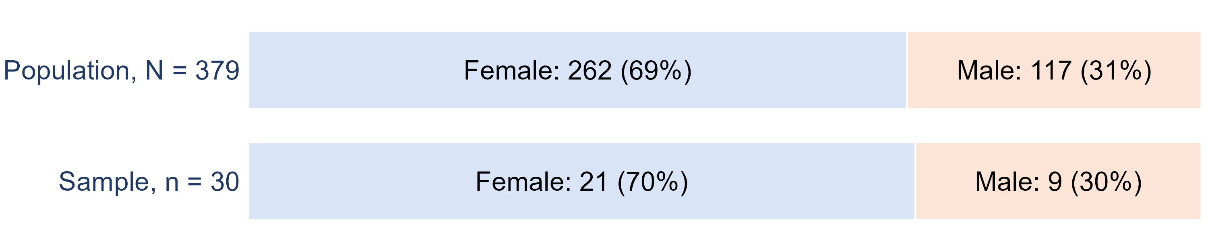
Proportional allocation with real data
heights.csv (on the course Data page) has N = 379 people: 262 female and 117 male. Stratify by sex for a sample of n = 30:
female: 30 x 262/379 = 20.74, so 21
male: 30 x 117/379 = 9.26, so 9
Then an SRS of 21 of the women, and a separate SRS of 9 of the men

Slide 10
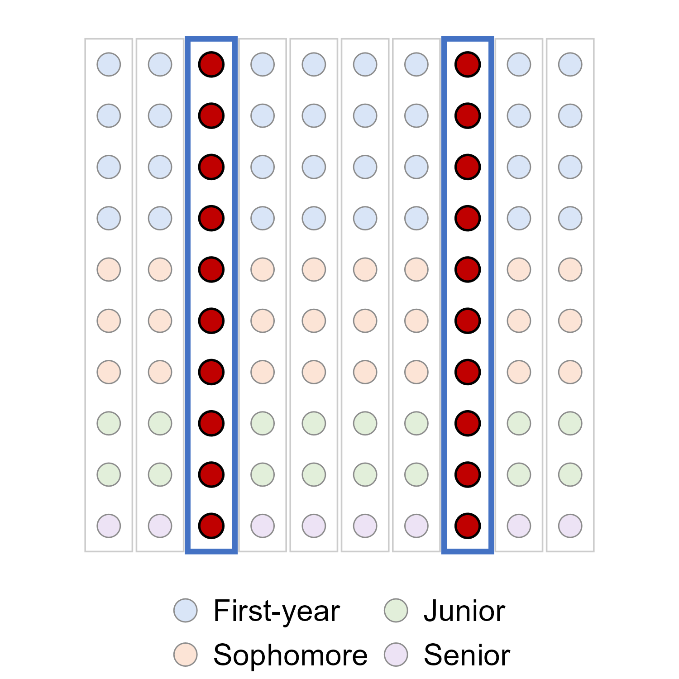
Cluster sample
cluster
a group of units that occurs naturally - a dorm, a classroom, a city block
cluster sample
an SRS of clusters, then measure EVERY unit in the clusters chosen
Only needs a list of clusters, not of every person - and far less travel
Works best when each cluster is a mini-population: mixed inside, like each column here

Slide 11
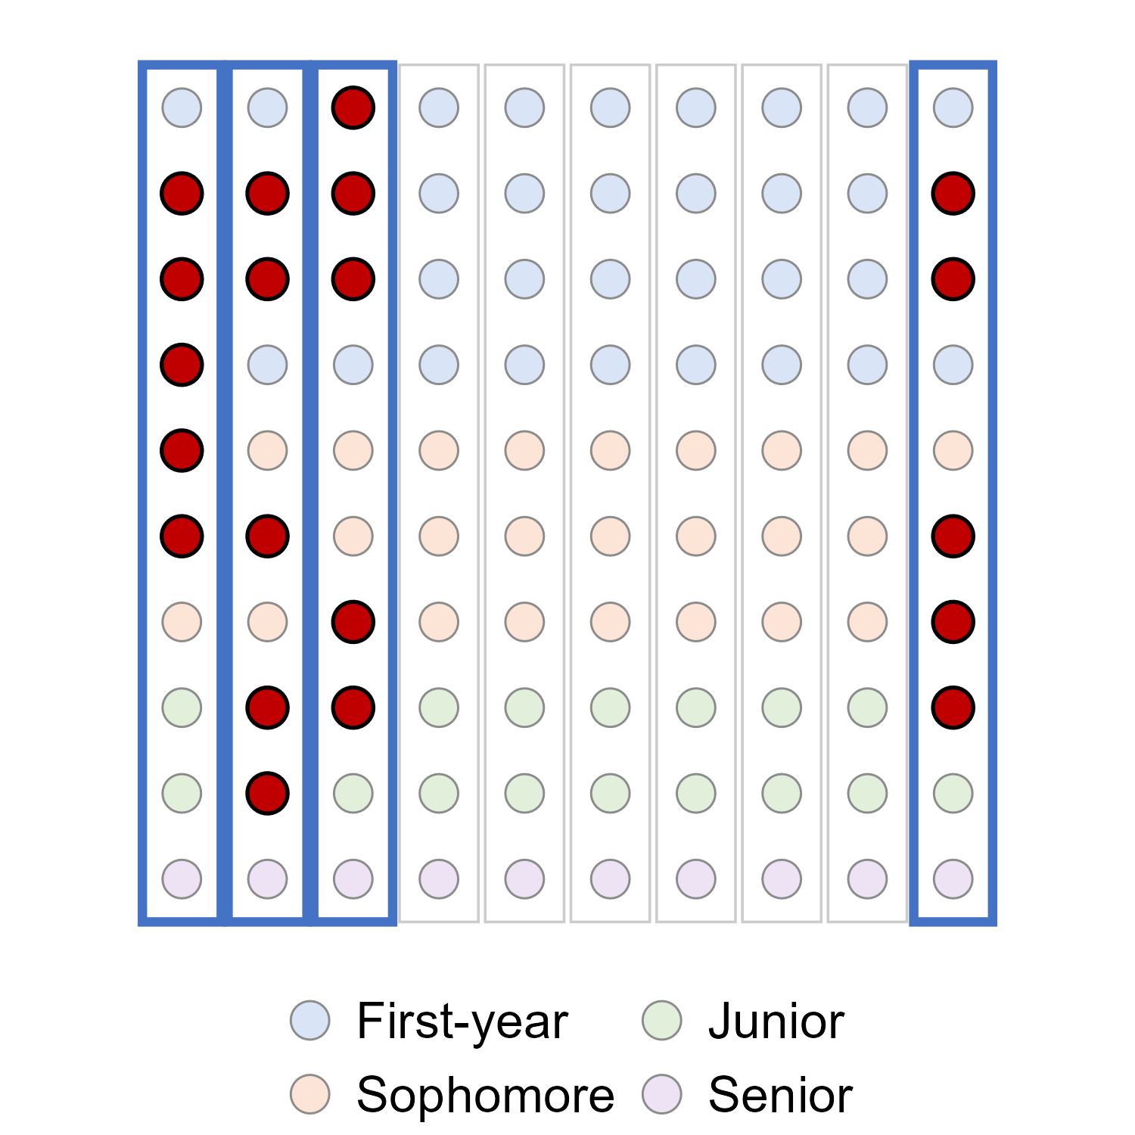
Two-stage cluster sample
two-stage cluster sample
stage 1: an SRS of clusters. Stage 2: an SRS of units inside each chosen cluster
Here: 4 of the 10 columns, then 5 students in each, n = 20
Exit polls work this way: sample polling places, then interview every nth voter leaving each one
National surveys such as NHANES stack it all: strata, clusters inside strata, households inside clusters

Slide 12
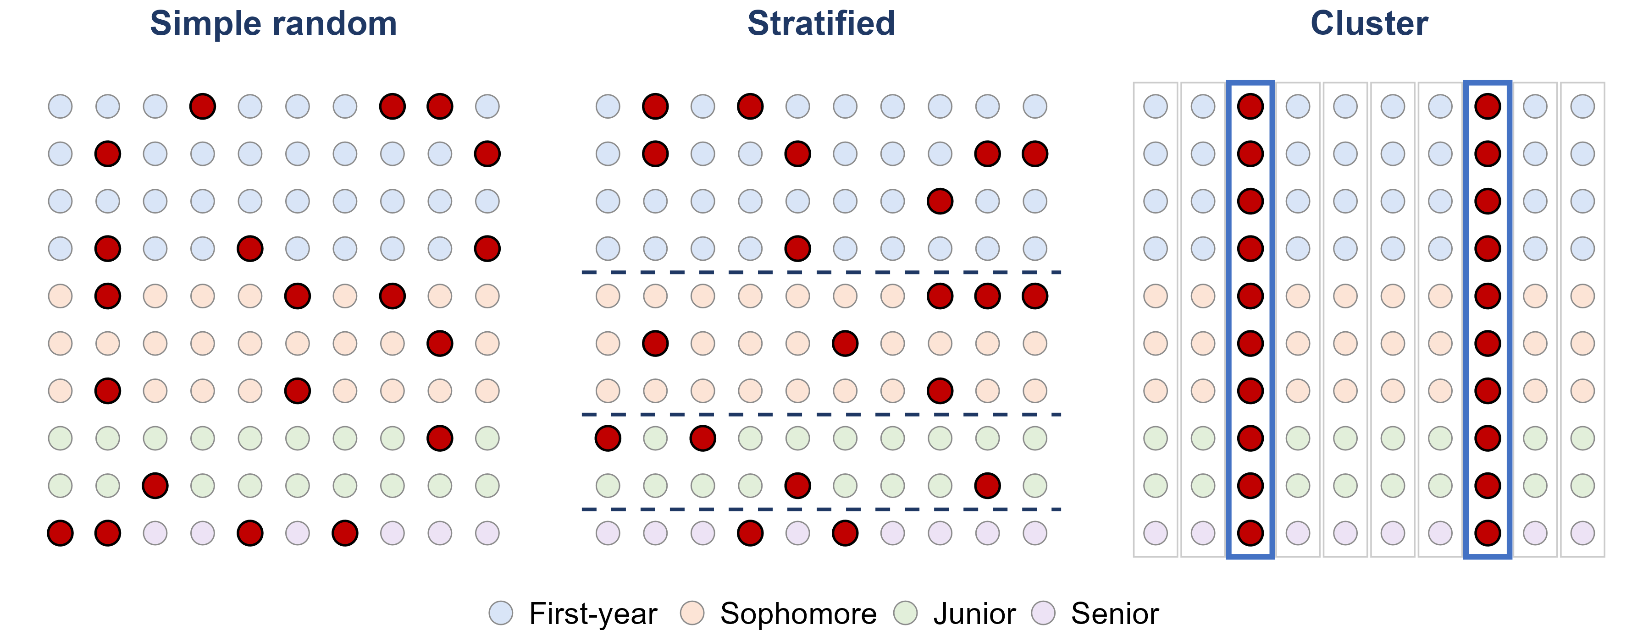
Strata vs. clusters
Strata: alike inside - sample from EVERY one. Clusters: mixed inside - sample SOME, whole.

Slide 13
Two kinds of error
sampling error
the natural gap between a sample and the population, caused by which units happened to be chosen
every sample has some - a larger sample makes it smaller
nonsampling error
errors that do not come from chance - biased methods, bad questions, data-entry mistakes, faulty instruments
a larger sample does not make these smaller
sampling bias
some members of the population are less likely to be chosen than others
convenience and voluntary response samples, or a frame that leaves people out

Slide 14
Three common nonsampling errors
Even a perfectly random design can end up biased:
undercoverage
the sampling frame leaves part of the population out
students who are not on the list you sampled from
nonresponse
people who are chosen cannot be reached, or refuse to answer
a problem when the people who do not answer differ from those who do
response bias
the answers themselves are wrong
leading or confusing questions, sensitive topics, wanting to please the interviewer

Slide 15
Nonresponse: when nobody picks up
Pew Research Center reached 36% of the people it called for its phone surveys in 1997. By 2018 it reached 6%.
1. Does a 6% response rate automatically make a survey biased?
No - only if the people who answer differ from the people who do not. The trouble is that you usually cannot check.
2. In 2020, national polls in the final two weeks overstated Biden's margin by 3.9 points on average - the largest error in 40 years. What could cause that?
The pollsters' own task force concluded that at least some of the error came from nonresponse: the people who answered differed from those who did not.
Sources: Pew Research Center (2019); AAPOR Task Force on 2020 Pre-Election Polling (2021)

Slide 16
Question wording: same law, two names
In September 2013, CNBC asked half of its poll respondents about “Obamacare” and the other half about “the Affordable Care Act” - the same law.
1. Which name do you think drew more opposition?
Obamacare: 46% opposed it, against 37% for the Affordable Care Act.
2. So did fewer people support Obamacare, too?
No - 29% supported Obamacare and 22% the ACA. 30% said they did not know about the ACA, but only 12% about Obamacare.
3. What does this tell you about survey questions?
The words in a question change the answers. A familiar, politically loaded name pulled people off the fence.
Sources: NBC News (September 27, 2013); Harvard Political Review

Slide 17
Practice: name the sampling design
1. A reporter interviews the first 50 students who walk out of the Idaho Student Union Building.
Convenience sample - only students who happen to pass the SUB can be chosen.
2. The registrar numbers every enrolled student, and a computer picks 200 of the numbers at random.
Simple random sample.
3. A principal polls 50 first-years, 50 sophomores, 50 juniors and 50 seniors, chosen at random within each year.
Stratified random sample - the class years are the strata.
4. 5 of the 40 apartment buildings in town are chosen at random, and every household in them is surveyed.
Cluster sample - the buildings are the clusters.
5. A medical researcher interviews every third patient on a hospital list, starting from a randomly chosen one of the first three.
Systematic sample, with k = 3.

Slide 18
Your course project: Part 3
Part 3 asks you to draw a sample of 20 to 30 observations from your dataset
Pick a design: simple random, systematic, stratified or cluster sampling
Say exactly how you drew it - the method, n, and the tool - so someone else could repeat it
Justify the choice for YOUR data: is there a natural group to stratify on? natural clusters?
Name any bias your method could introduce
Steps 1 to 4 of the project can be started as soon as this lecture is finished

Slide 19
Part 2
Experiments and Causation

Slide 20
Observational studies and experiments
response variable
the outcome we measure
heart disease
explanatory variable
the variable we think explains or influences the response
hormone therapy (yes or no)
observational study
observe individuals and measure variables, without influencing anything
survey women about the hormones they chose to take
experiment
the researcher deliberately assigns treatments, then measures the response
randomly assign women to hormones or a placebo
Ask: who decided which group each unit ended up in? The units themselves -> observational. The researcher -> experiment.

Slide 21
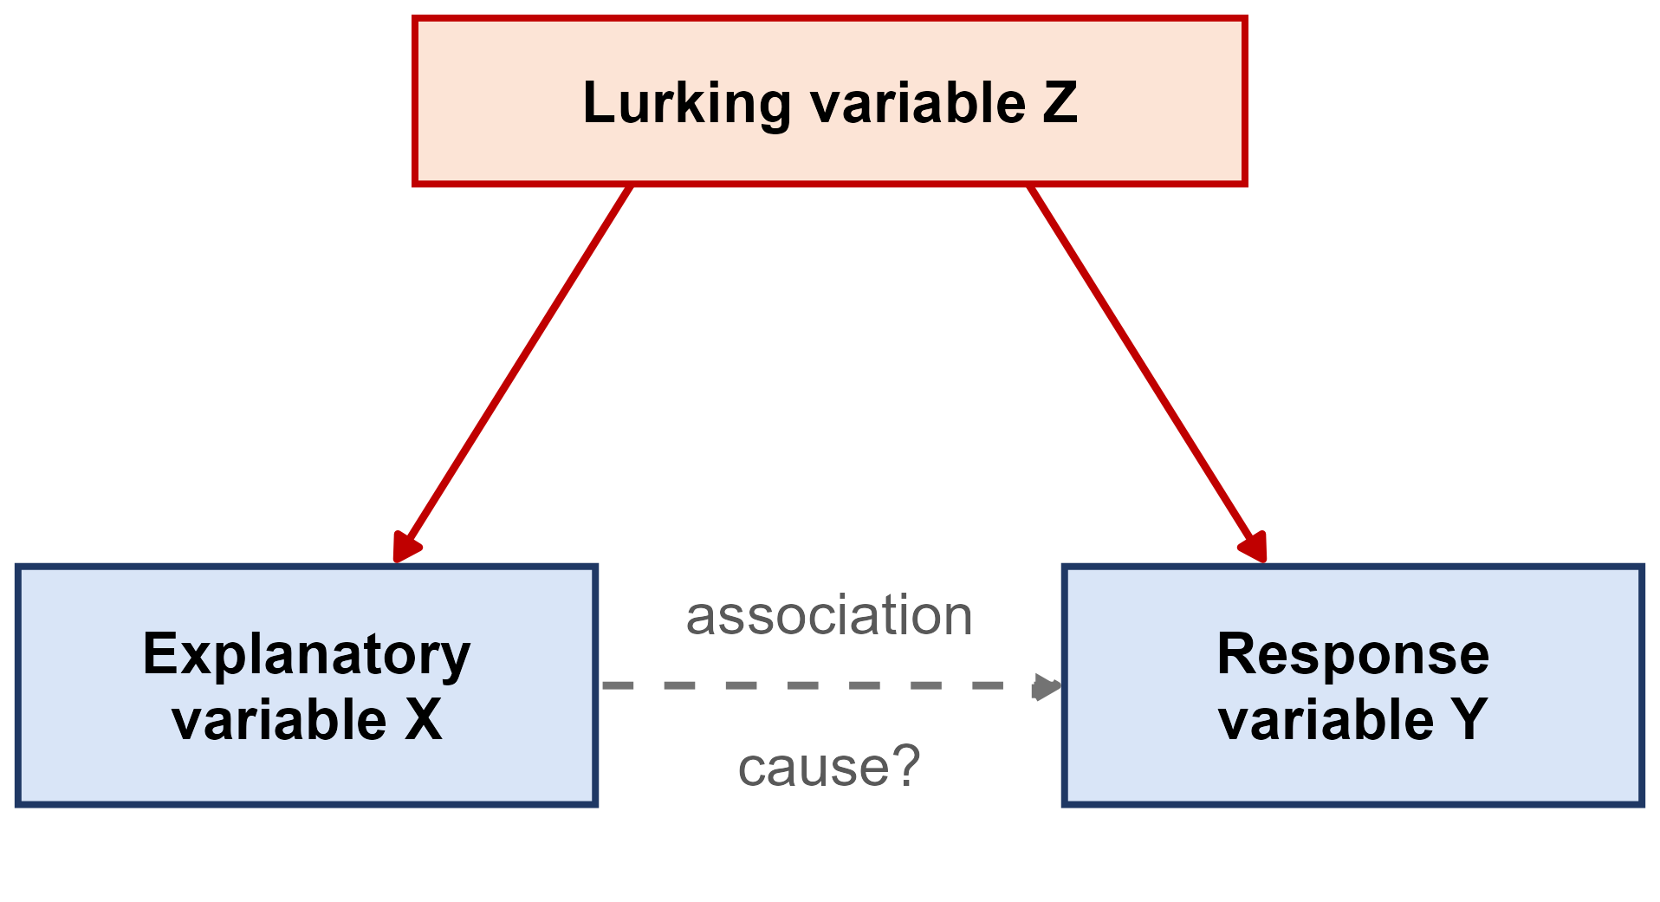
Association is not causation
association
two variables move together in the data
causation
changing one variable would change the other
lurking variable
a variable not in the study that influences both the explanatory and the response variable
confounded
two variables whose effects on the response cannot be separated
Ice cream sales and drownings rise together. The lurking variable: hot weather. The association is real - the causal story is not.

Slide 22
Hormone therapy and heart disease
Large observational studies, such as the Nurses' Health Study, found that women who took hormone therapy after menopause had less heart disease
The Women's Health Initiative then randomly assigned 16,608 women aged 50 to 79 to estrogen plus progestin or a placebo
It was stopped early in 2002 because the risks outweighed the benefits: more breast cancer, and MORE heart disease, not less
Why did the observational studies point the wrong way?
Lurking variables.
Women who chose hormone therapy tended to be wealthier, better educated and healthier to start with - and that,
not the hormones, lowered their heart risk. Random assignment balanced those differences out.
Source: Writing Group for the WHI Investigators (2002), JAMA

Slide 23
Coffee and the risk of death
The NIH-AARP study followed 402,260 adults aged 50 to 71 from 1995 to 2008. Before adjusting for anything but age, men who drank 6+ cups of coffee a day had a 60% HIGHER risk of death than men who drank none
But 35% of those heavy coffee drinkers smoked, compared with 5% of the men who drank no coffee
After adjusting for smoking and other factors, the same men had a 10% LOWER risk of death - and fewer deaths from heart disease
Why did the coffee effect flip?
Lurking variable: smoking.
Heavy coffee drinkers smoked far more, and smoking - not coffee - raised their risk. Even after adjusting, the authors say they cannot tell whether coffee itself helps.
Source: Freedman et al. (2012), New England Journal of Medicine

Slide 24
Can we claim cause without an experiment?
Nobody can randomly assign people to smoke for thirty years - or randomly assign their birth order
Yet we are confident that smoking causes lung cancer. Decades of observational studies found:
  a strong association, found again and again in different populations
  a dose-response pattern: the more cigarettes, the higher the risk
  the right order in time: the smoking comes before the cancer
  a plausible biological explanation, backed by laboratory evidence
The 2014 Surgeon General's report: smoking causes at least 480,000 premature U.S. deaths a year, about 127,700 of them from lung cancer
Without an experiment, a causal claim needs this much evidence - never one study
Source: U.S. Department of Health and Human Services (2014)

Slide 25
Back to light at night and the heart
Recall the UK Biobank study from slide 6: 11,071 adults wore a wrist light sensor for 7 days in 2013-2015, then had a heart MRI about 3 years later.
1. Is this an observational study or an experiment?
Observational. Nobody was assigned a bright or a dark bedroom - the light people already had was measured.
2. People with the most light above 3 lux had 1.5% thicker heart walls than people with none. Did the light cause it?
This study cannot tell us. It shows an association - the authors say their design cannot establish cause.
3. The press release was titled “Too much light at night changes the shape and working of the heart.” Fair?
It goes too far. The paper says more night light was associated with these changes, not that it changed the heart.
Sources: Dai et al. (2026) and Münzel, Kuntic and Daiber (2026), European Heart Journal; ESC press release (2026)

Slide 26
Light at night: how strong is the evidence?
The authors adjusted for age, smoking, physical activity, BMI, air pollution, deprivation and more. The heart changes grew steadily as night light went up.
1. They adjusted for many variables. Is that as good as random assignment?
No. Adjusting only handles what was measured. Traffic noise was not, and the editorial says it could confound.
2. Which features from the smoking evidence does this study have? What is it missing?
Time order, a dose-response and a plausible link (shorter sleep). Missing: many studies finding it again.
3. The participants were volunteers, mostly White and healthier than average. Who can we generalize to?
Only people like them. Volunteers are not a random sample of any population.
Sources: Dai et al. (2026) and Münzel, Kuntic and Daiber (2026), European Heart Journal

Slide 27
The language of experiments
experimental units
the individuals or objects the treatments are applied to
subjects
experimental units that are people
factor
an explanatory variable the researcher controls
levels
the specific values a factor is set to
treatment
the condition a unit receives: one combination of factor levels

Slide 28
Example: the VITAL trial
VITAL randomly assigned 25,871 U.S. adults to vitamin D (2,000 IU a day) or a placebo, AND to omega-3 fish oil (1 g a day) or a placebo, then followed them for about 5 years.
1. What are the experimental units - and what do we call them?
The 25,871 adults. They are people, so they are subjects.
2. What are the factors, and how many levels does each have?
Vitamin D and omega-3 - 2 levels each (the supplement or a placebo).
3. How many treatments are there?
2 x 2 = 4: vitamin D + omega-3, vitamin D + placebo, placebo + omega-3, placebo + placebo.
4. What happened?
Neither supplement lowered the rate of invasive cancer or of major cardiovascular events.
Source: Manson et al. (2019), New England Journal of Medicine

Slide 29
Principles of experimental design
control
compare the treatment against a control group, so the treatment is the only systematic difference between the groups
random assignment
let chance assign units to treatments - it balances the lurking variables we know about AND the ones we do not
replication
put enough units in each group that chance differences between the groups average out

Slide 30
Placebos and blinding
placebo
an inactive treatment that looks exactly like the real one
a sugar pill, or a saline injection
placebo effect
people often improve simply because they believe they are being treated
in one study, believing you had taken a performance drug worked almost as well as the drug itself
blinding
the subjects do not know which treatment they received
double-blind
neither the subjects nor the researchers working with them know who received what

Slide 31
The 2020 Pfizer-BioNTech vaccine trial
43,548 people were randomly assigned, half and half, to two shots of the COVID-19 vaccine or two shots of a saline placebo. Participants and the staff assessing them did not know who got which. Afterwards: 8 COVID-19 cases in the vaccine group, 162 in the placebo group.
1. Why give the control group a saline shot instead of no shot at all?
So both groups have the same experience. A difference in cases can then only come from the vaccine, not from expectations.
2. Why randomize, instead of letting people choose whether to get the vaccine?
People who choose a new vaccine may also be more careful in other ways - a lurking variable. Randomizing balances it.
3. What does 8 cases versus 162 suggest?
The vaccine group had about 95% fewer cases - and because of the design, we can credit that to the vaccine.
Source: Polack et al. (2020), New England Journal of Medicine

Slide 32
A placebo surgery
Arthroscopic knee surgery for arthritis was common, and patients said it helped
Moseley and colleagues (2002) randomly assigned 180 patients with knee osteoarthritis to two real arthroscopic procedures, or to placebo surgery - skin incisions only, with no instruments inserted
Patients, and the staff who assessed their pain, did not know who got which
Over two years, which group reported the most improvement?
None of them.
The placebo group did as well as both surgery groups on pain and function. The benefit came from believing
you had surgery - and without a placebo group and blinding, nobody would have known.
Source: Moseley et al. (2002), New England Journal of Medicine

Slide 33
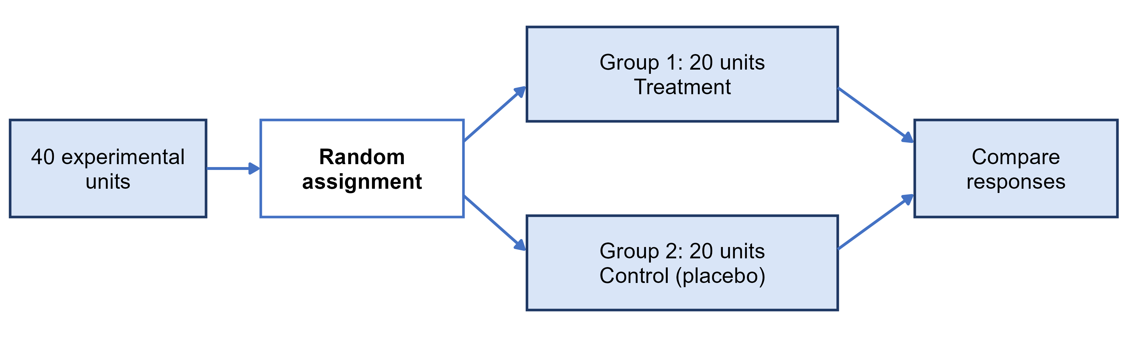
Completely randomized design
completely randomized design
every unit is assigned to a treatment completely at random - the simplest design
The Pfizer-BioNTech vaccine trial was a completely randomized design with two groups

Slide 34
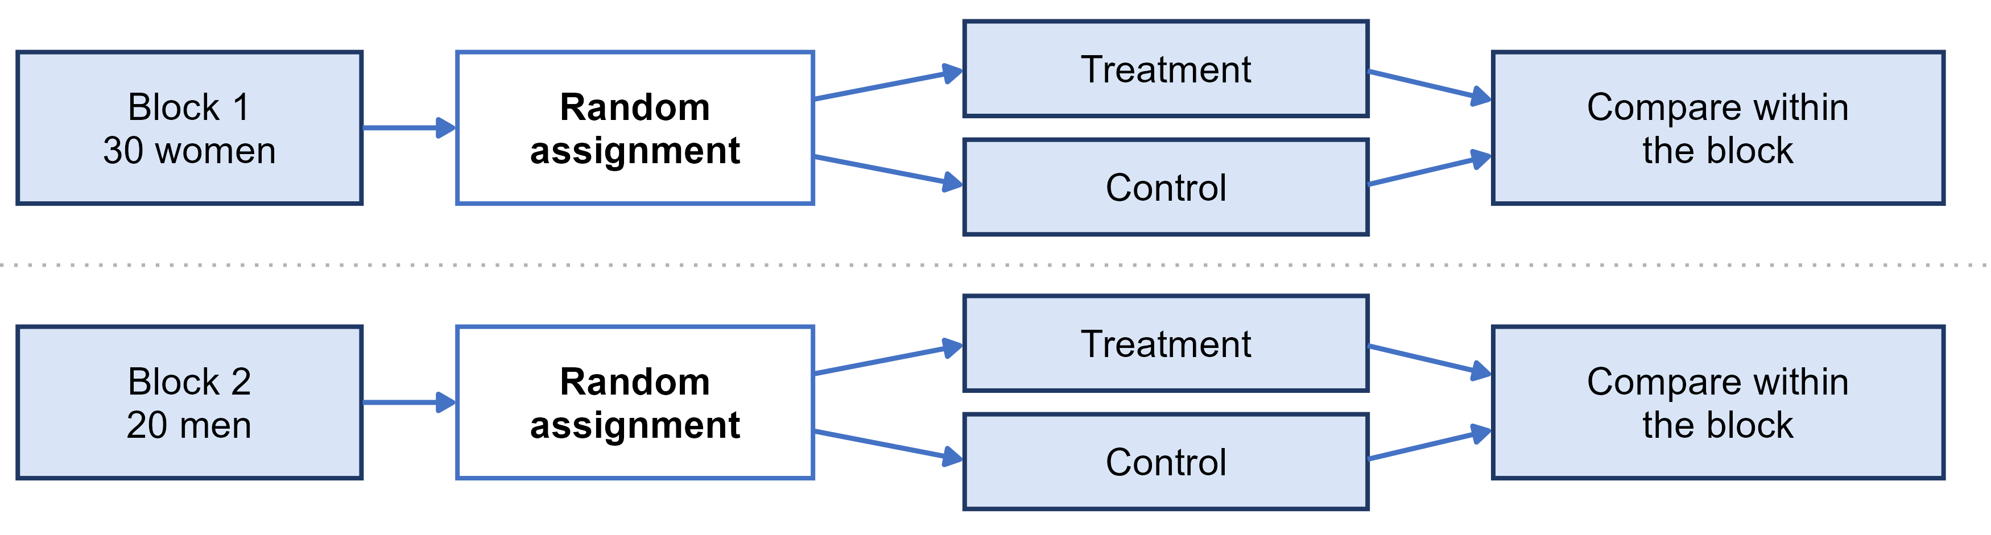
Randomized block design
block
a group of units that are alike in a way that affects the response, formed BEFORE treatments are assigned
randomized block design
randomize treatments separately inside each block, then compare treatments within blocks
blocking is to experiments what stratifying is to sampling

Slide 35
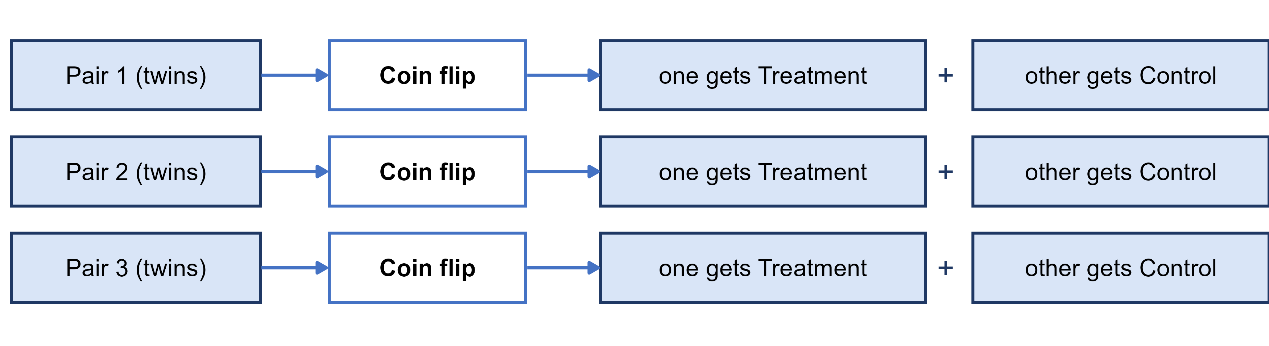
Matched pairs design
matched pairs design
a block design where every block is a pair of very similar units, and a coin flip decides which one gets each treatment
or each subject is their own pair, receiving both treatments in a random order
Before-and-after data with no random order or control group is much weaker evidence

Slide 36
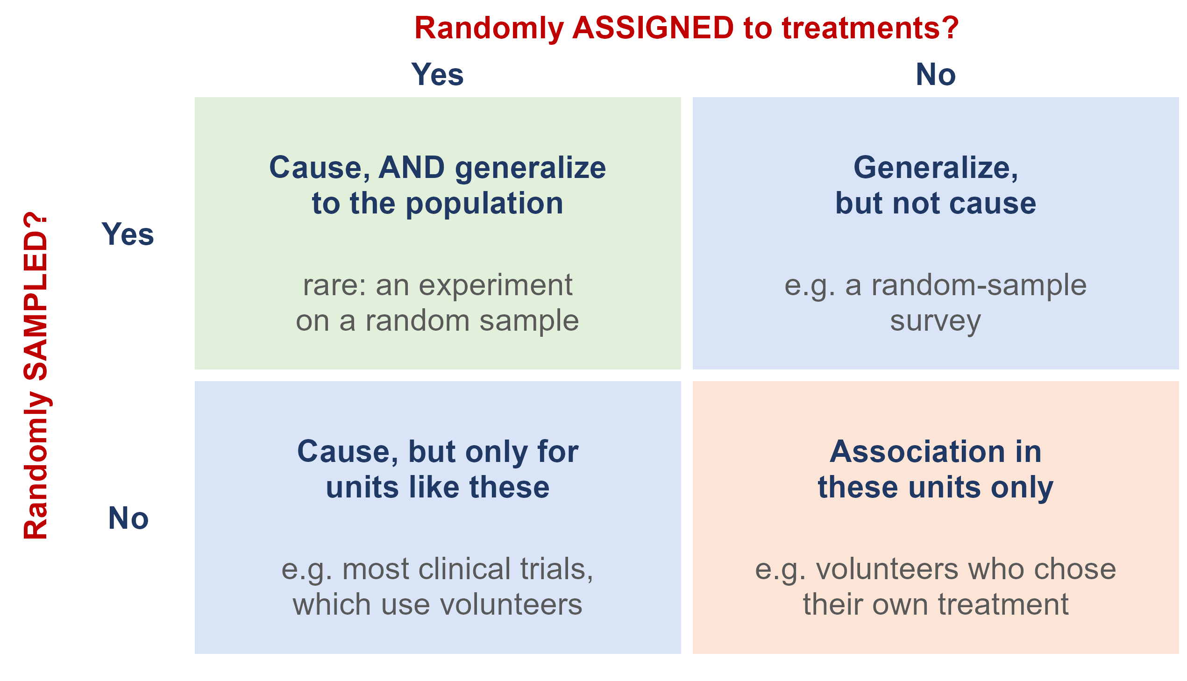
What does randomization buy you?
Random sampling lets you generalize from the sample to the population
Random assignment lets you conclude cause and effect
Most studies have only one. A trial on volunteers shows a vaccine works - for people like those volunteers

Slide 37
Practice: design the study
You want to know whether texting slows how quickly a driver reacts when the car ahead brakes.
1. What are the explanatory variable, the response variable, and the treatments?
Explanatory: texting or not. Response: reaction time. Treatments: driving while texting, and driving only.
2. Your partner wants to split drivers at random into a texting group and a driving-only group. Is there a better design?
Matched pairs: each driver does both, in a random order. Reaction times vary a lot between people, so compare each driver to themselves.
3. Can the study be blinded?
Not for the drivers - they know when they are texting. But the person measuring reaction times can be kept blind.
Adapted from Introductory Statistics 2e (OpenStax), Section 1.4, Try It 1.21

Slide 38
Ethics: the Facebook experiment
For one week in January 2012, Facebook changed the News Feeds of 689,003 users: some saw fewer positive posts, some fewer negative ones. The results were published in 2014. The users never knew.
1. Facebook said agreeing to its Data Use Policy counted as informed consent. Do you agree?
The journal did not: its Expression of Concern said the study may not have met the principles of informed consent and the chance to opt out.
2. Why did no ethics board stop it?
Facebook, a private company, was not bound by the federal rules. Cornell's board decided its researcher was not directly involved, so it did no review.
3. What is the lesson?
Clicking I agree on a terms-of-service page is not informed consent - even for a well-designed experiment.
Sources: Kramer, Guillory and Hancock (2014), PNAS; PNAS Editorial Expression of Concern (2014)

Slide 39
The Belmont Report: three principles
Why the rules exist: in the U.S. Public Health Service syphilis study at Tuskegee (1932 to 1972), hundreds of Black men with syphilis were left untreated without informed consent. The Belmont Report (1979) followed.
respect for persons
people decide for themselves whether to take part
beneficence
do no harm: maximize the possible benefits and minimize the possible risks
justice
the burdens and benefits of research are shared fairly

Slide 40
Research ethics today
informed consent
subjects are told the purpose, procedures and risks in advance, and can refuse or quit at any time
confidentiality
information about individuals is protected and never released in a form that identifies them
Institutional Review Board (IRB)
reviews and approves studies on human subjects before they start
at UI, through the Office of Research Assurances

Slide 41
Ethics: honest data
Ethics also means honest data. An investigation of psychologist Diederik Stapel found he had invented data: it tainted more than 55 of his papers and 10 PhD dissertations he supervised. A researcher is surveying households in a community:
1. They choose a block where they already know many of the neighbors. What is the problem?
A convenience sample - it is biased, and claiming it represents the community is misleading.
2. Nobody is home at four houses, so they skip them and never go back. What is the problem?
Nonresponse - people who are not home, such as working families, may differ from the people who are.
3. Running late, they fill in four forms with answers copied from neighbors. What is the problem?
Fabricated data. It is never acceptable, even when the answers look realistic.
Source: Introductory Statistics 2e (OpenStax), Section 1.4 and Example 1.22

Slide 42
Practice: what design, and can it show cause?
1. A survey finds that people who own dogs have lower blood pressure than people who do not.
Observational - nobody was assigned a dog. Active people may both own dogs and have lower blood pressure.
2. 60 volunteers with insomnia are randomly split: 30 get melatonin, 30 get an identical-looking placebo.
Completely randomized experiment - it can show cause, for people like these volunteers.
3. In each of 4 greenhouses, tomato plants are randomly assigned to fertilizer A or fertilizer B.
Randomized block design, with greenhouses as the blocks - it can show cause.
4. Subjects complete mazes wearing a floral-scented mask and an unscented mask, in a random order. Can the subjects be blinded?
No - they can smell the flowers. But the researchers timing the mazes can be blinded. (Textbook Example 1.20)

